Slide 1
LOGISTIC REGRESSION
Presented by:
RAM REDDY
DEEKSHITA SAIKIA
PANTH SHAH
#sg_agile_squad
A BRIEF OVERVIEW WITH A WORKING EXAMPLE
08/08/2020

Slide 2
Where does it fit in?
MACHINE LEARNING
SUPERVISED LEARNING
UNSUPERVISED LEARNING
CLASSIFICATION
REGRESSION
CLUSTERING
ASSOCIATION
Here!
Notes:
Reinforcement learning

Slide 3

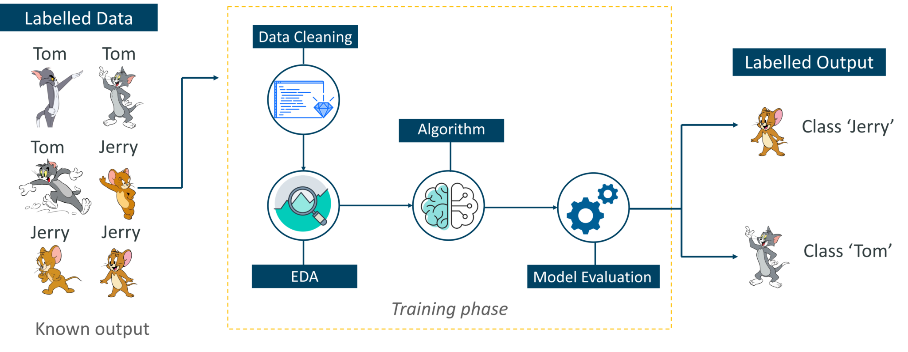
What is logistic regression?
Type of supervised algorithm used for binary and multi-class classification problems
Beware!
Although it is named a regression, it is actually a classification process

Slide 4
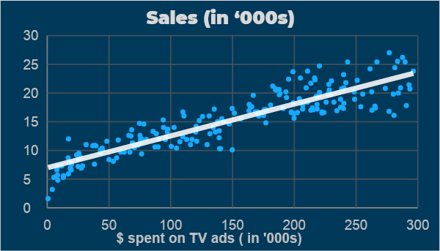
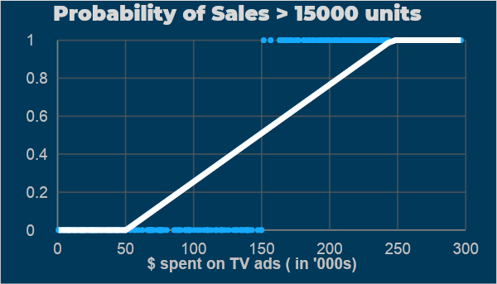
Why not use linear regression?
REGRESSION PROBLEM
rfsgdsf
CLASSIFICATION PROBLEM
Predict quantity of sales given $ spent on TV ads
Good fit, low error!
dfffsa
Predict if quantity of sales > 15000 (y/n) given $ spent on TV ads
No fit, very high error!

Slide 5
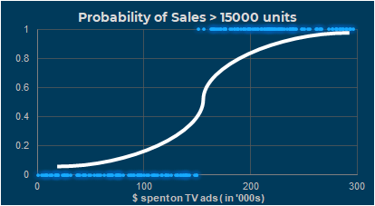
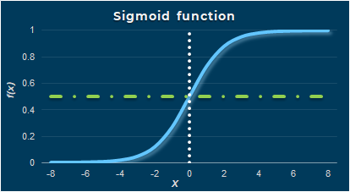

How to solve this?
This curve would fit better!
This is called a sigmoid curve.
Threshold usually set at zeroth value of 0.5

Slide 6






Math behind Logistic Regression
ODDS OF AN EVENT
REGRESSION EQUATION
$$θ=\frac{p}{1 −p}$$
p being the probability of the event
$$y=β0+ β1X$$
β₀ - intercept, β – coefficients, X - dependents
$p$ ranges from 0 to 1
$θ$ranges from 0 to ∞
$y$ ranges from -∞ to ∞
$\log{ (\frac{p(x)}{1 −p(x)}})=β0+β1X$
$$p(x)=\frac{1}{1+ ℯ^{−(β0+β1X)}}$$
Both sides range from -∞ to ∞
Sigmoid function!

Slide 7
How does Logistic Regression Learn?
Problem – Maximise estimation of likelihood
- conditional probability / likelihood of observing the data given the model parameters
$$L\left(X, θ\right)$$
𝐿(𝑋, 𝜃)
$$max\sum_{i}^{n}{}{}\log{ (\hat{y}i)∗yi+\left(1−\log{\hat{y}i}\right)∗(1−yi)}$$
〖max∑_𝑖^𝑛〗⁡ log⁡〖 (𝑦 ̂_{𝑖})∗𝑦_{𝑖}+(1−log⁡〖𝑦 ̂_{𝑖〗 )}∗(1−𝑦_{𝑖})〗
Solution - Method of Gradient Descent
Contd…

Slide 8
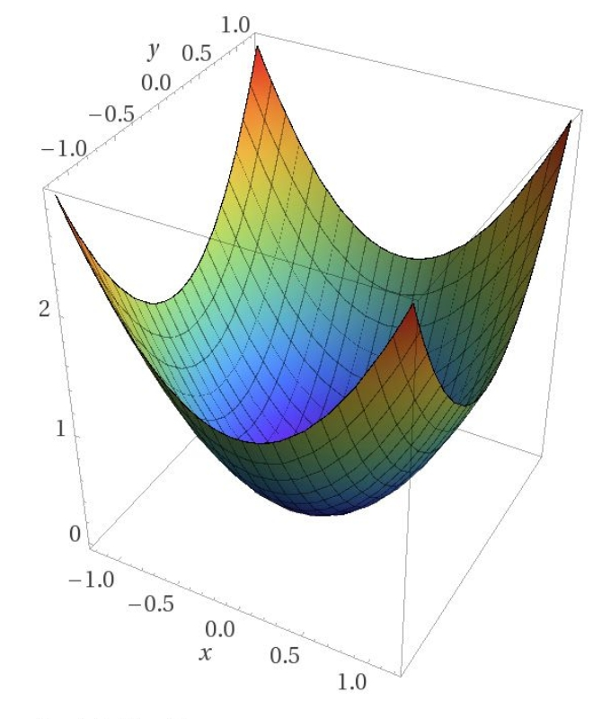

$$β0= β0 −l ∗ δβ0 \\ β1=β1 −l ∗ δβ1 \\ l −learning rate$$
Method of Gradient Descent

Slide 9
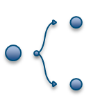


Assumptions for logistic regression
Appropriate outcome structure – binary regression requires binary outcomes, ordinal regression requires ordinal outcomes
Observation Independence
Absence of multicollinearity among features
Linearity of independent variables and log odds
Large sample size

Slide 10
Evaluation metrics
Accuracy
Confusion Matrix
Precision
Recall
ROC AuC
F1 Score

Slide 11

THANKS!
DO YOU HAVE ANY QUESTIONS?
Type in the chat box or get in touch through dedicated Slack thread!
#sg_agile_squad
THANKS

Slide 12
REFERENCES
Slide 3, Picture Credits : https://www.edureka.co/blog/introduction-to-machine-learning/
Slide 8, Picture Credits : https://blog.paperspace.com/intro-to-optimization-in-deep-learning-gradient-descent/

